Slide 1






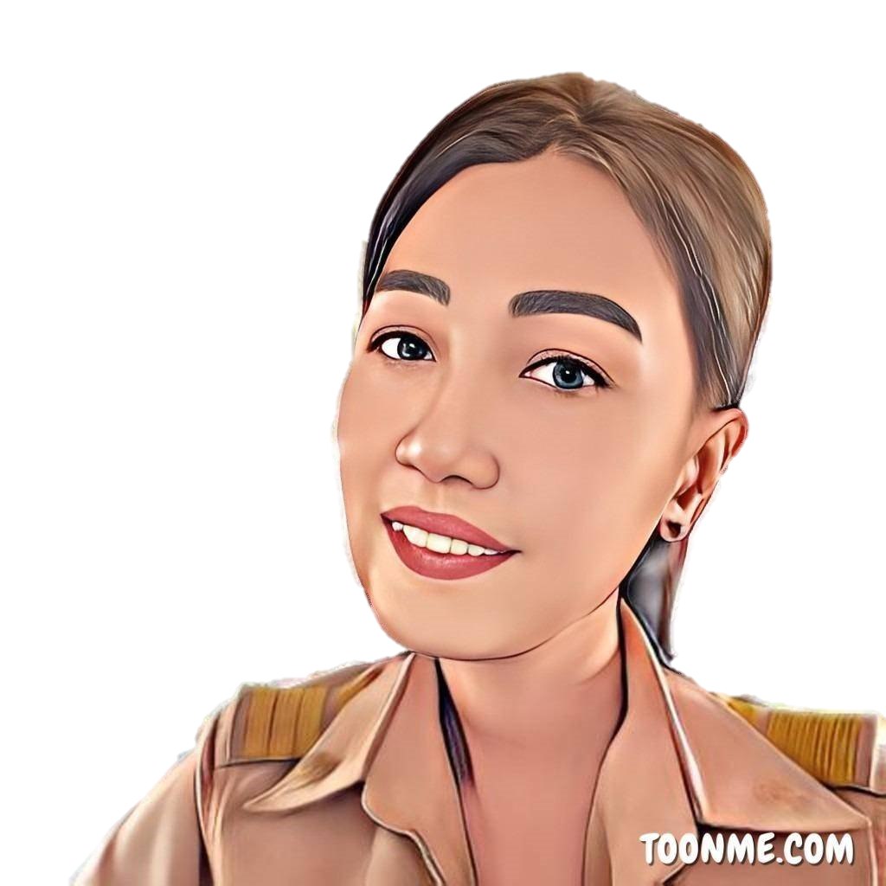



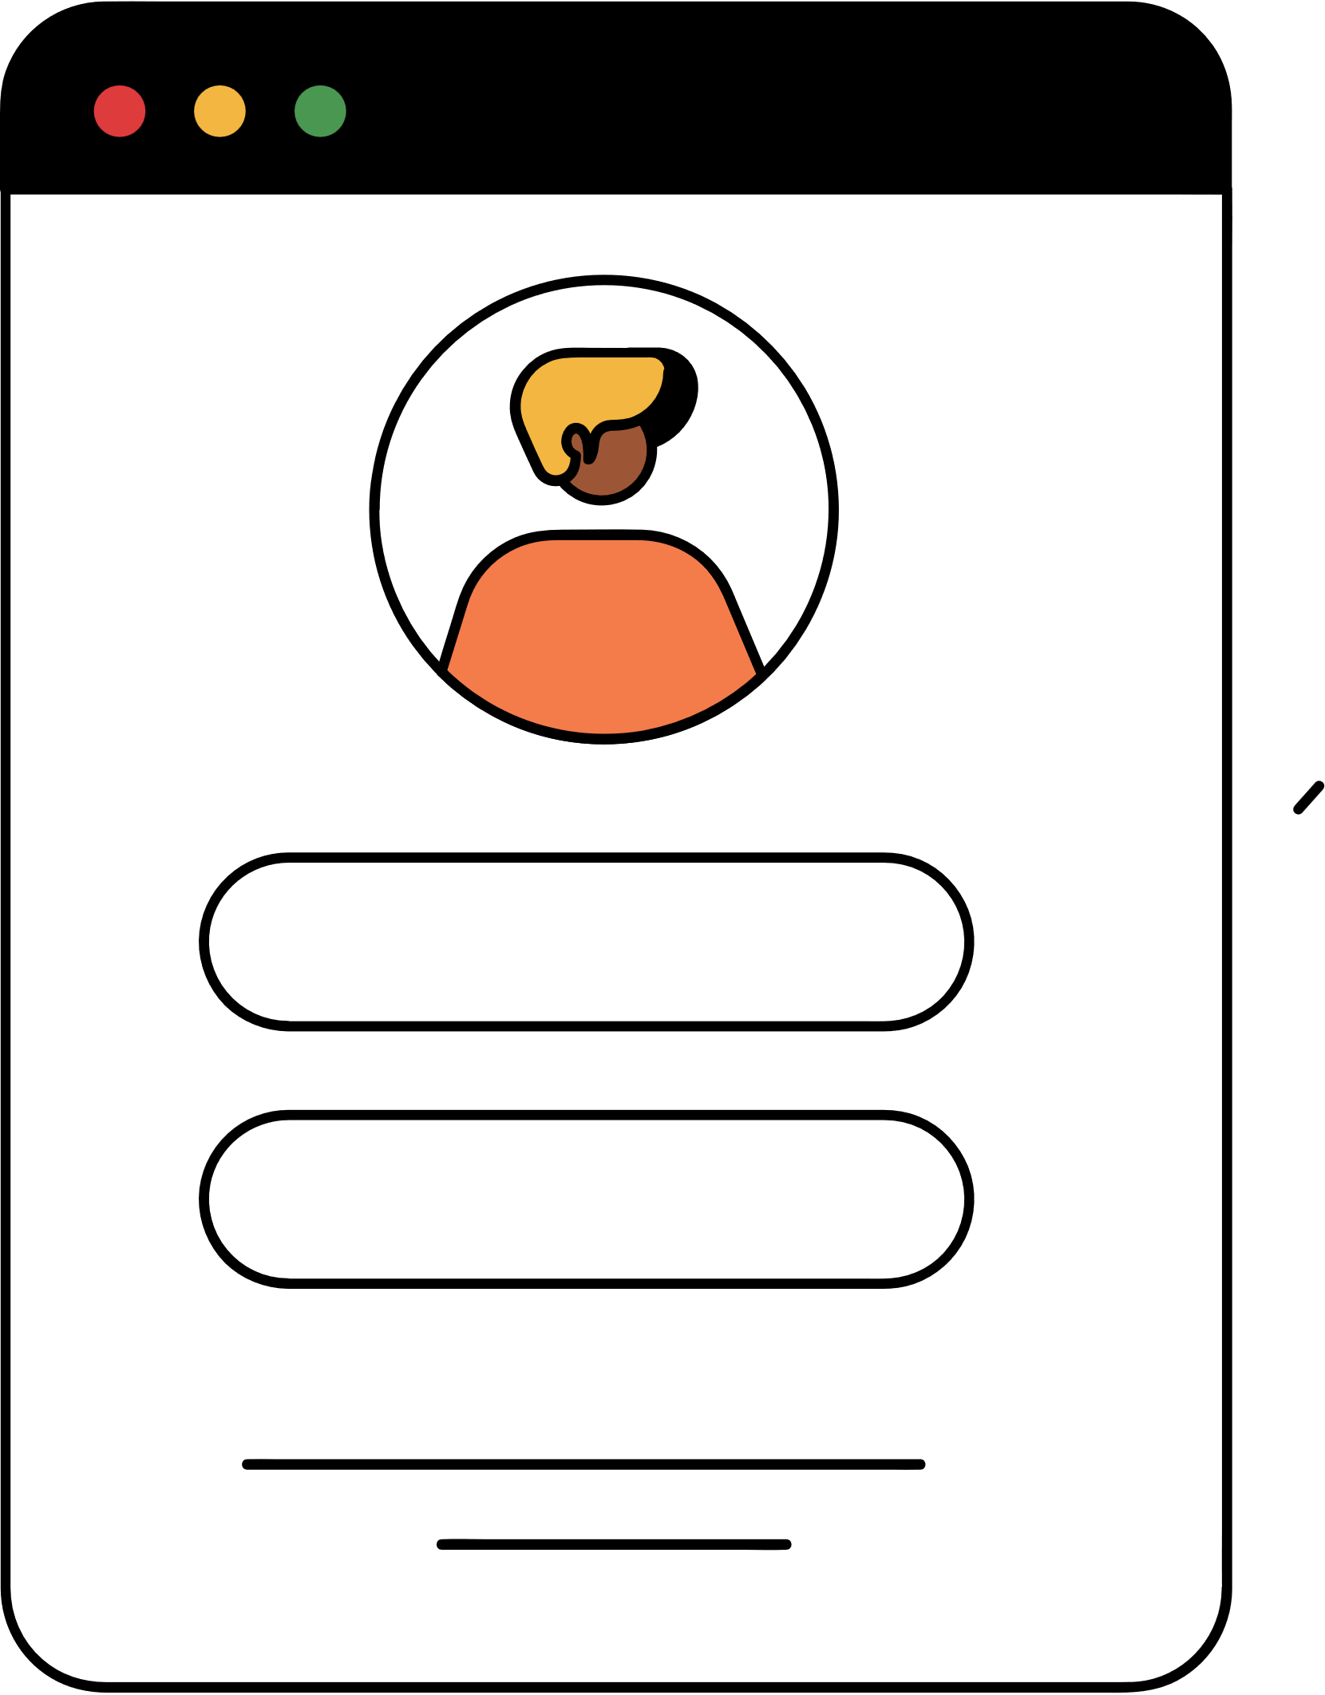

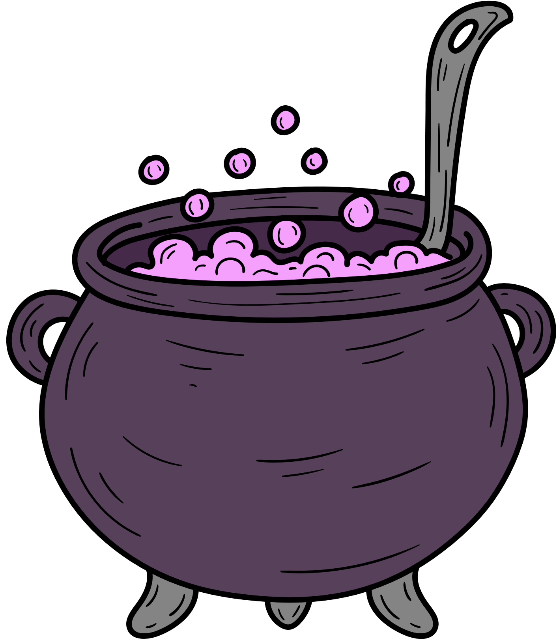


Welcome to my class
Present Simple
Present Continuous
By Teacher Duangruthai Hitted

Slide 2


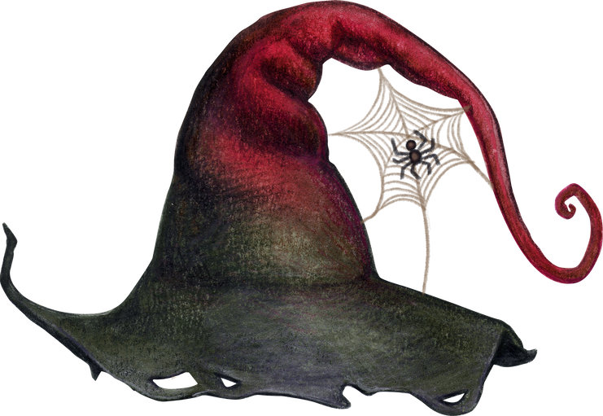
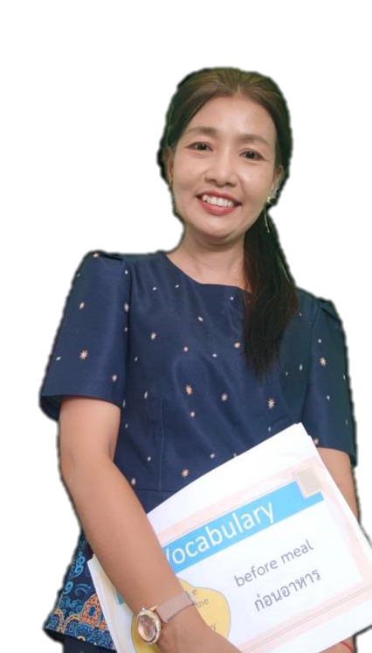
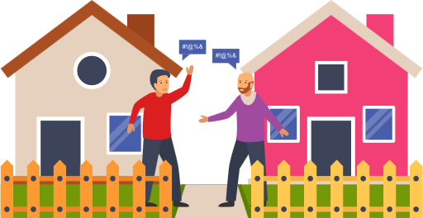
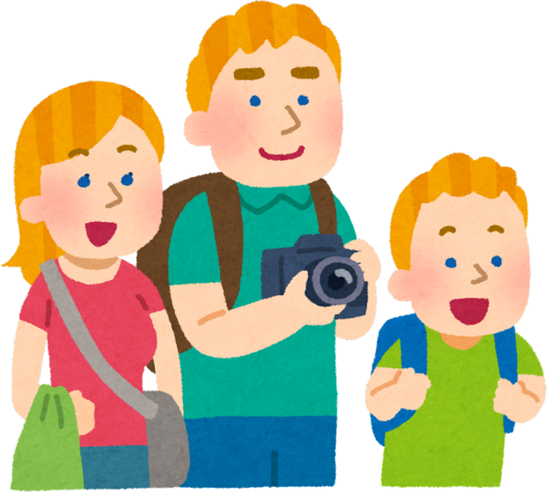

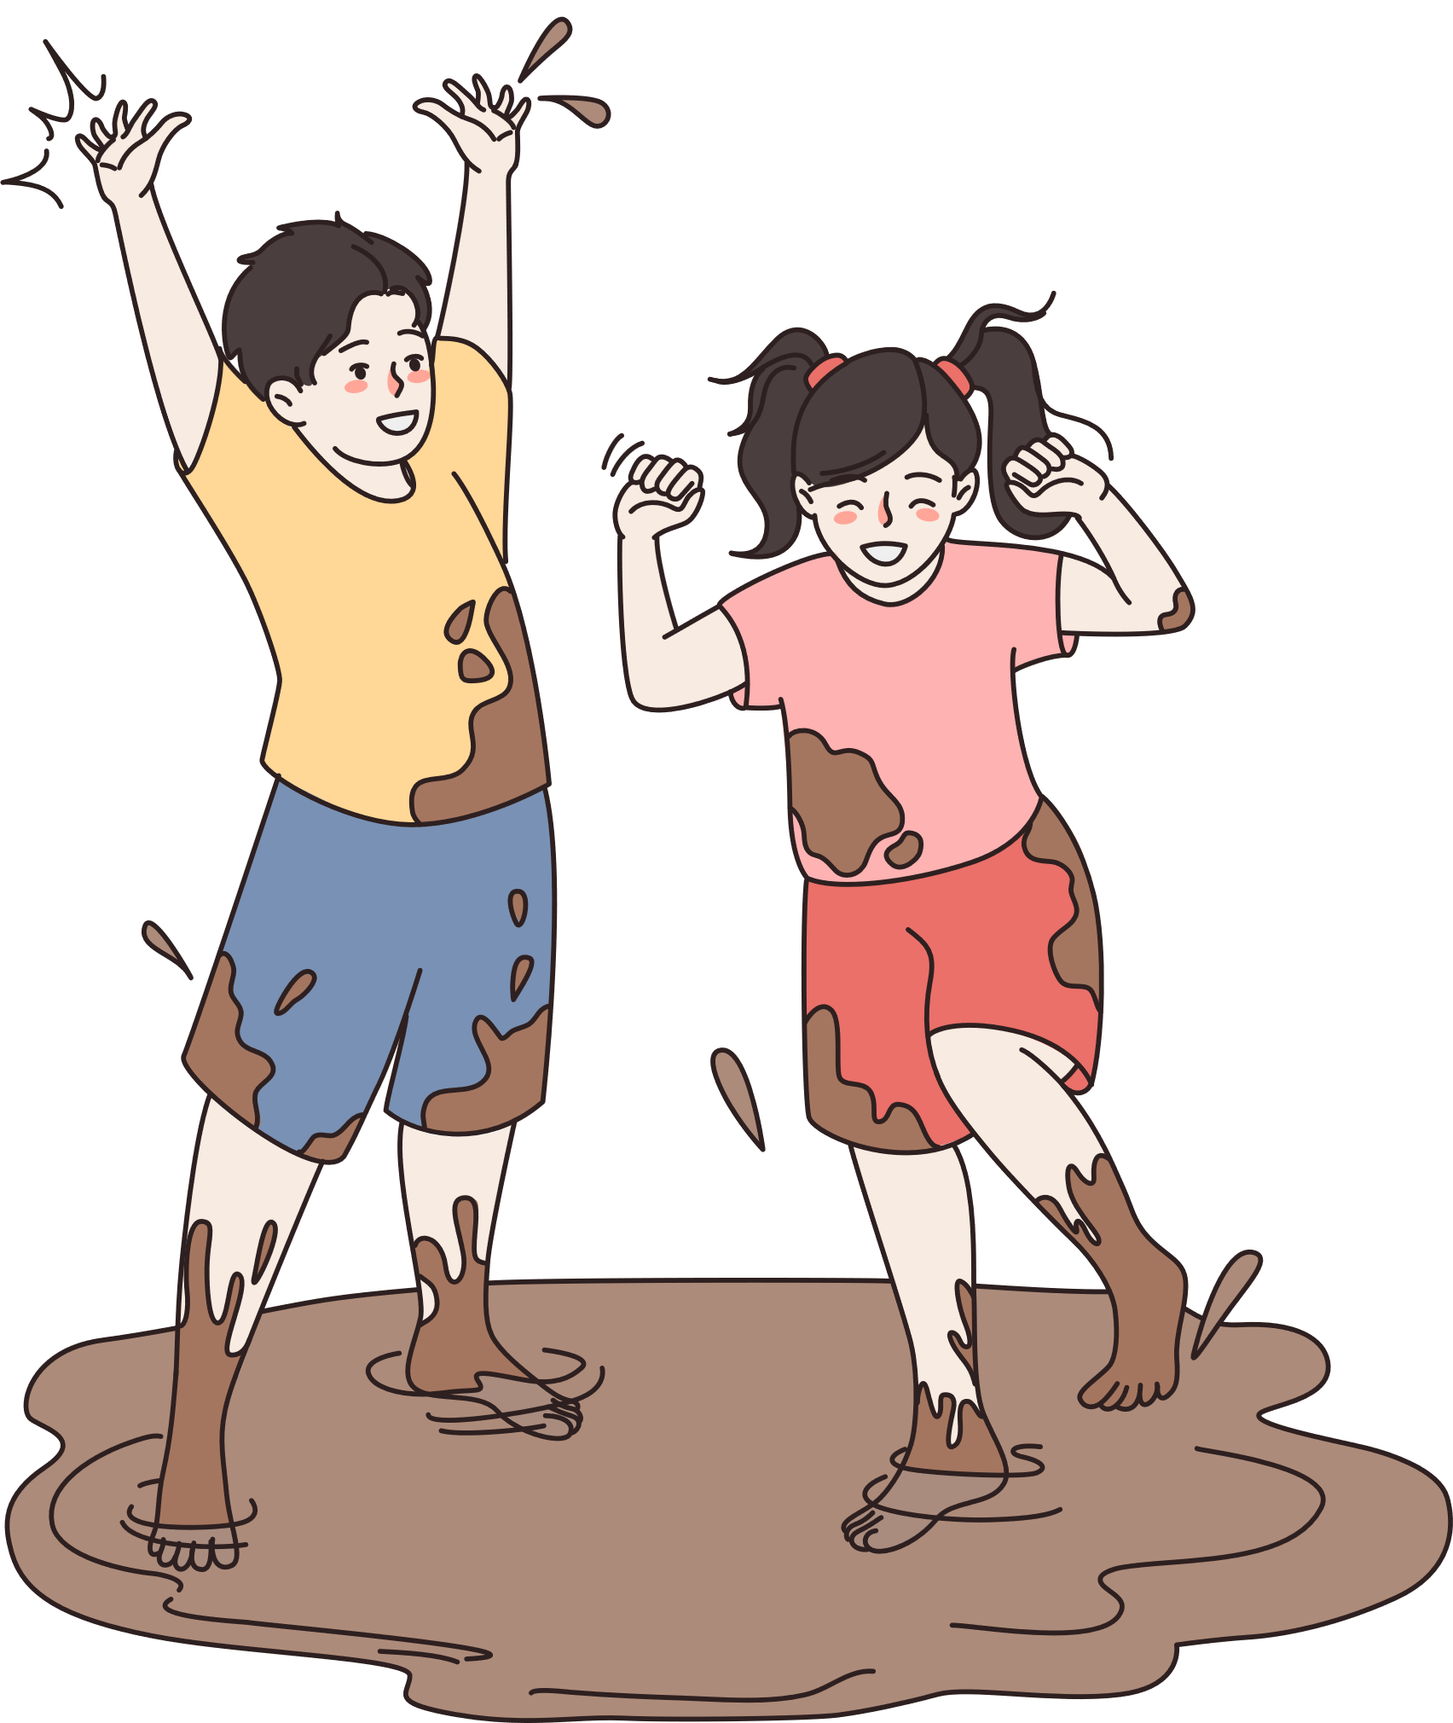
Learning Vocabulary
foreign
fact
profile
information
neighbor
tourist
member
playmate

Slide 3



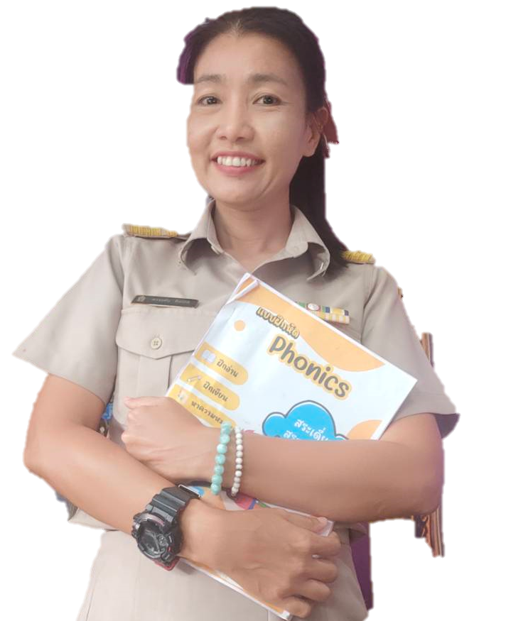
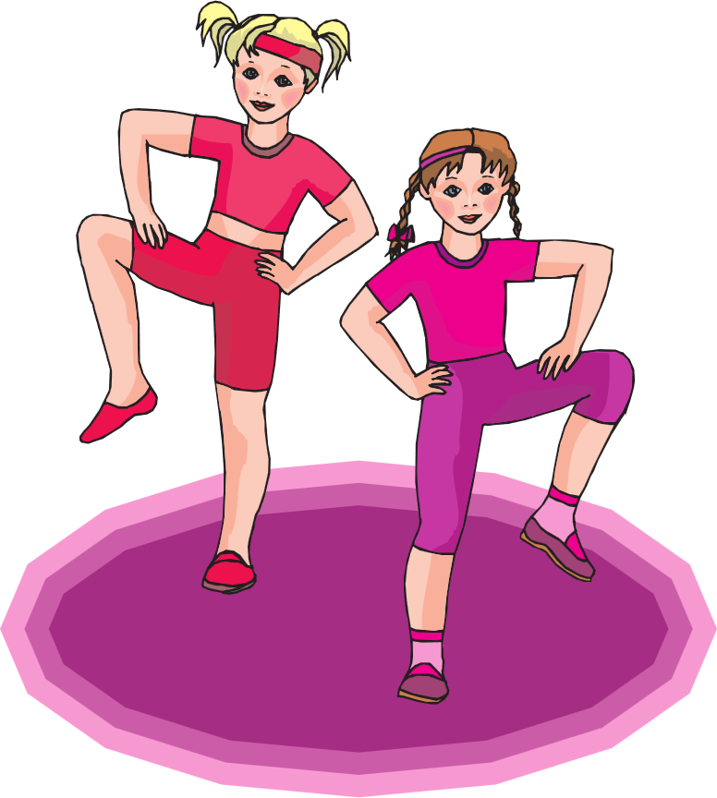

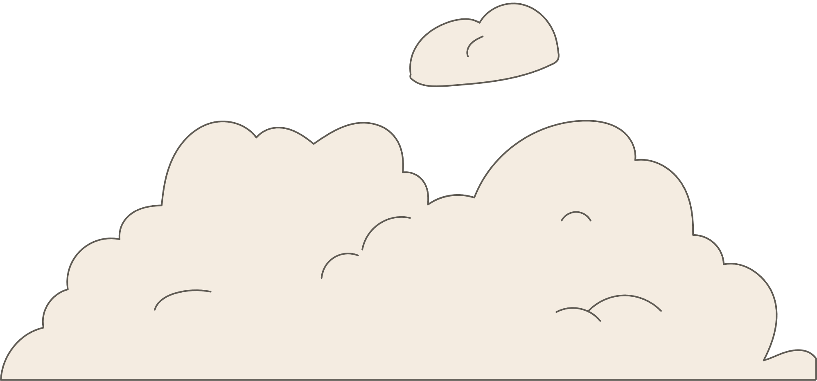
Conversation Invitations & Responses
Questions
- Will you listen to the radio with me?
- Do you want to play this card game?
- Would you like to join my aerobics class?
Answers
- Of course! I’d love to!
- Sorry, I can’t. I have to study.
- I’m sorry. I’m going to meet our teacher soon.

Slide 4
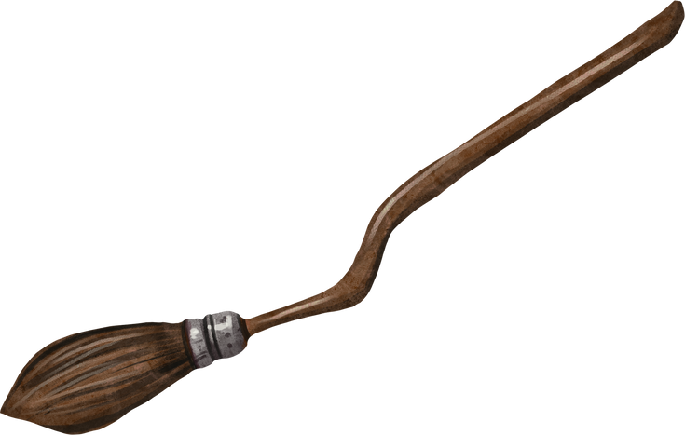
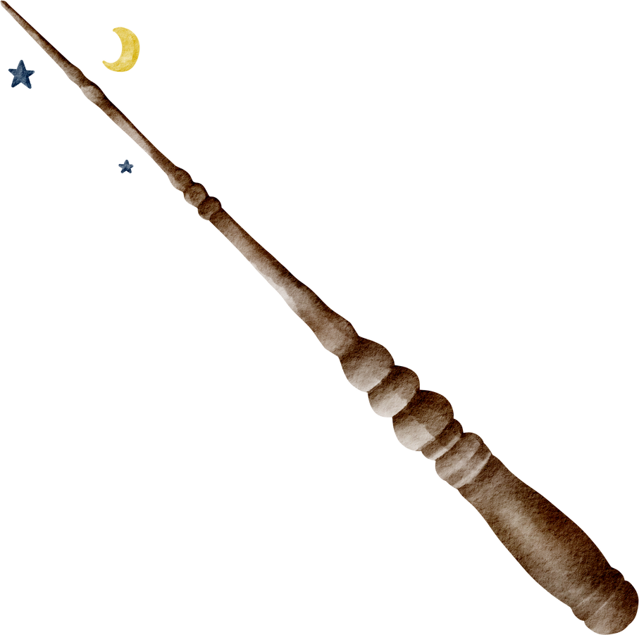

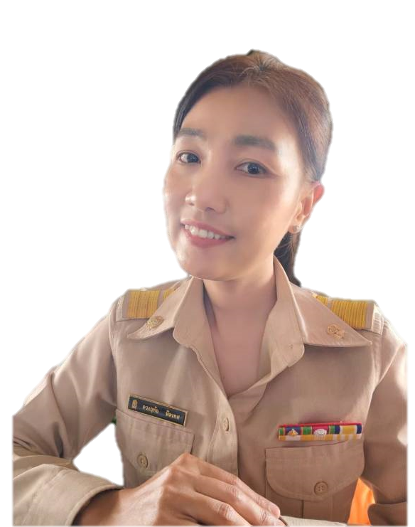

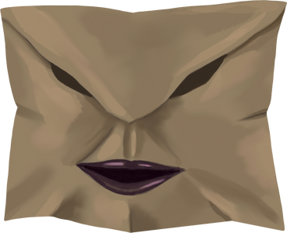

How the Present Simple Tense is Formed
Subject
Verb
Rest of Sentence
He / She / It
eats
dinner at 7 pm every day.
I / You / They / We
eat

Slide 5

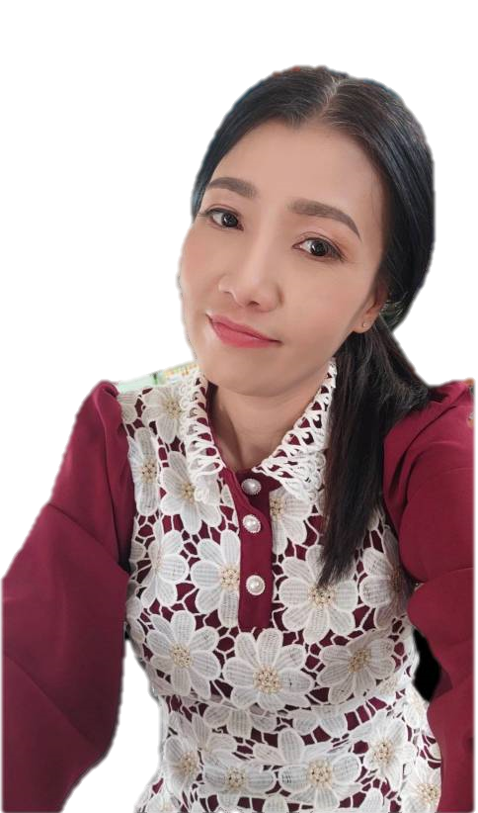

How the Present Continuous Tense is Formed
Subject
is,am,are
Verb -ing
Rest of Sentence
He / She / It
is eating
at 7 a.m. every day.
I / You / They / We
am/are studying

Slide 6
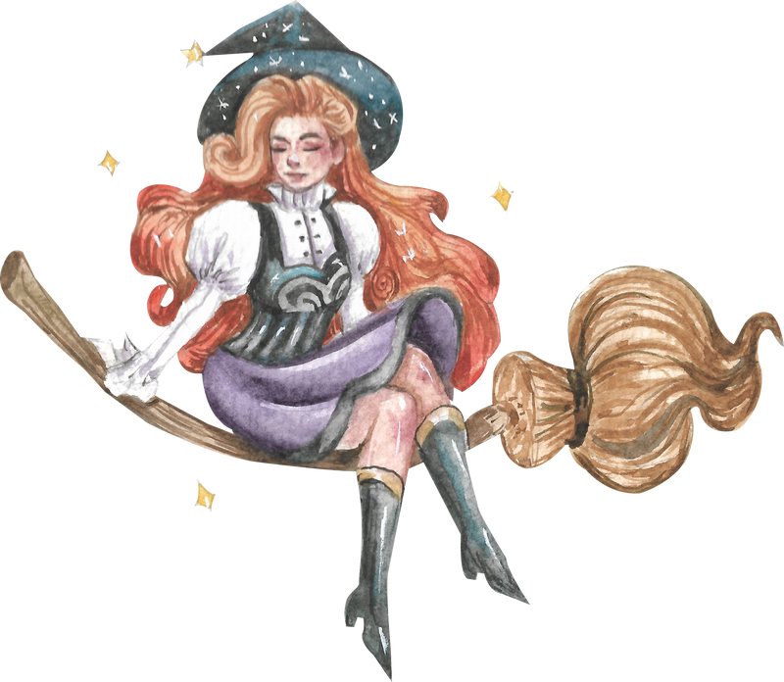

Present Simple
Present Continuous
S + Verb (s,es)
S + is,am,are + V.ing
Express general truths
Describe actions happening now
  It rarely rains in the desert.
  She is reading a newspaper upstairs.
Indicate present habits
Express annoying habits (+ always)
  The birds return to the island every morning.
  You're always forgetting to pay the bills.
Express timetable events
Describe future arrangements (informal)
  The plane to London takes off at 6:30 a.m.
  She's getting married on 3 November.
Indicate permanent states
Express temporary states
  I like the new James Bond film.
  She's working at the museum until the
end of this month.

Slide 7
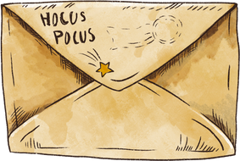
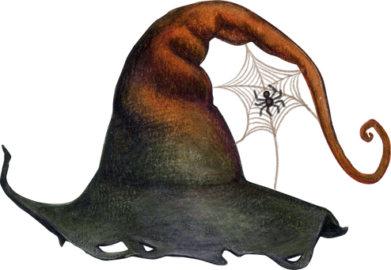
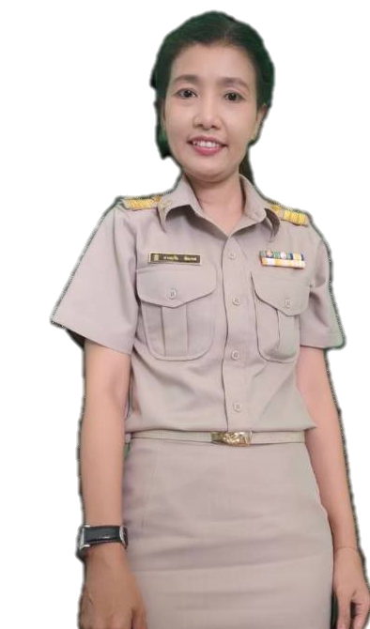
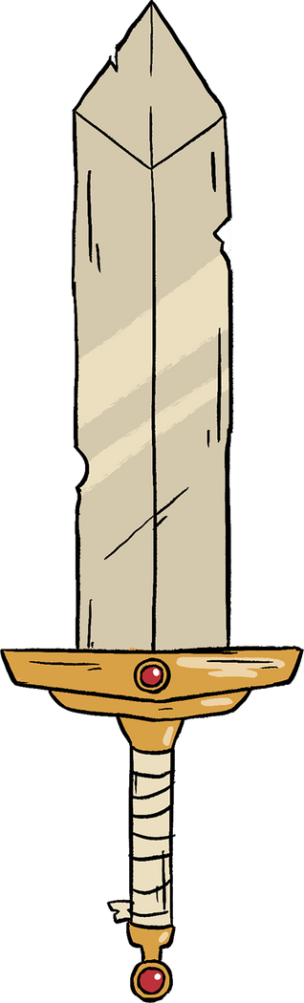




Present Simple
Present Continuous
Let's Practice
check on the type of sentence.
I always play tennis after school.
I am watching a movie at the moment.
I never eat bananas.
Bears sometimes eat salmon.
We are learning Korean these days.

Slide 8


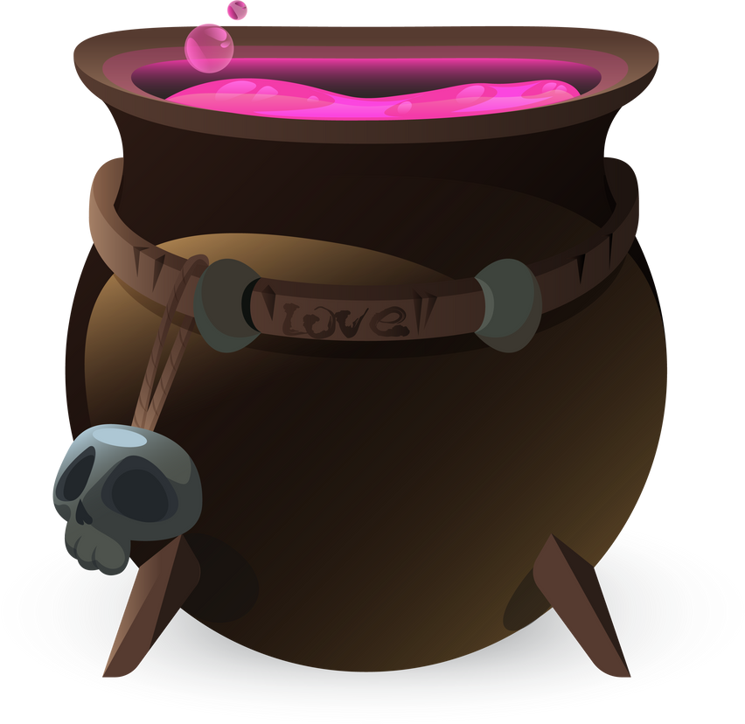
Make a sentence
Present Simple
Present Continuous

Slide 9
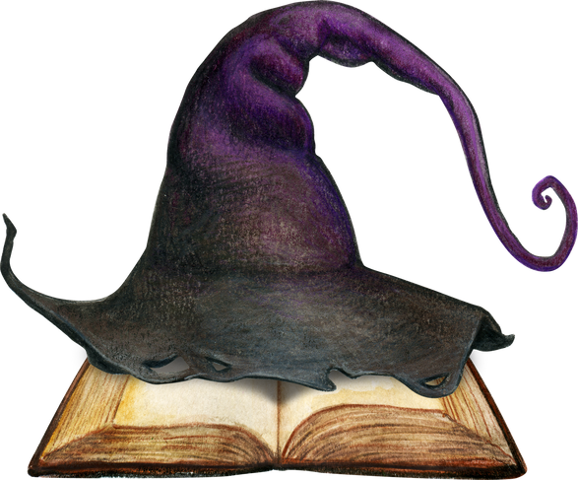
Write personal profiles

Slide 10

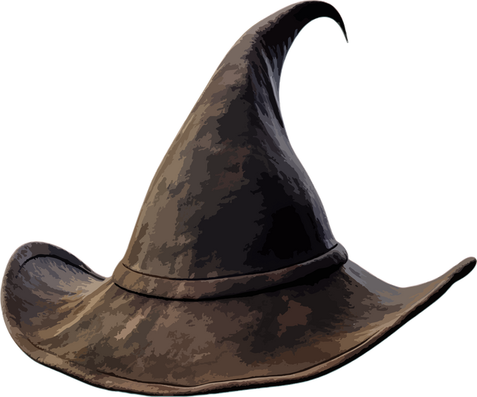
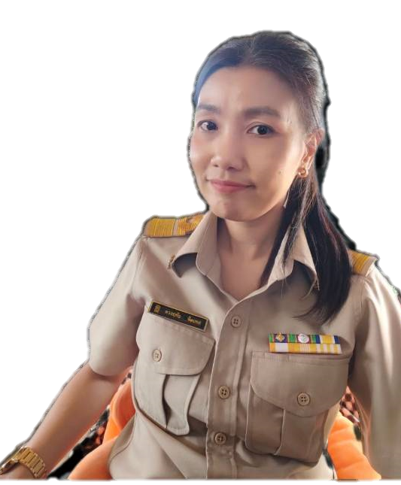
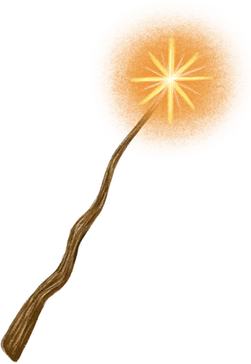
Thank You

