Slide 1







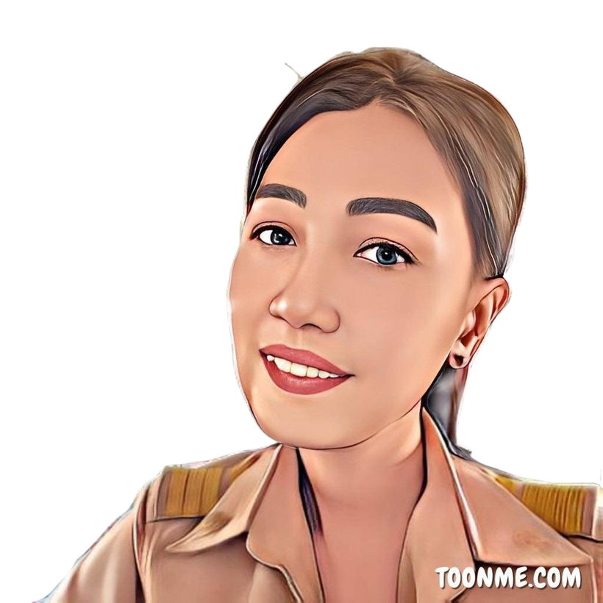

GUESSING GAME
?
?
?

Slide 2
GUESSING GAME
READY
GO!

Slide 3
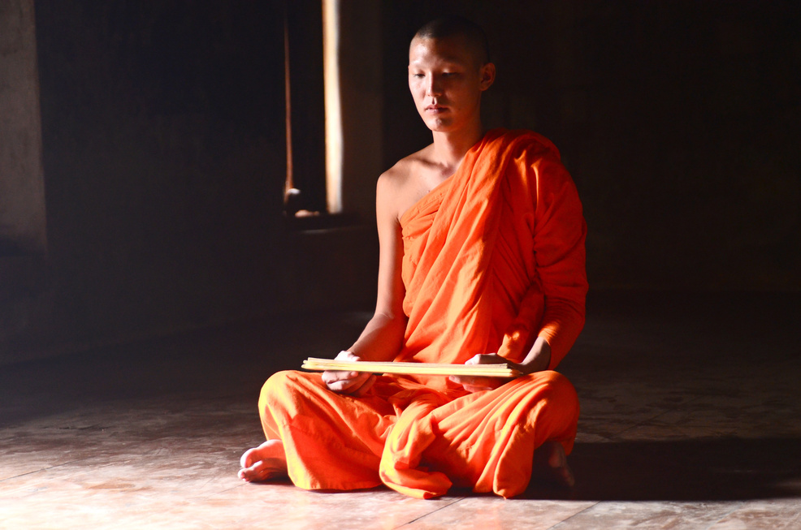
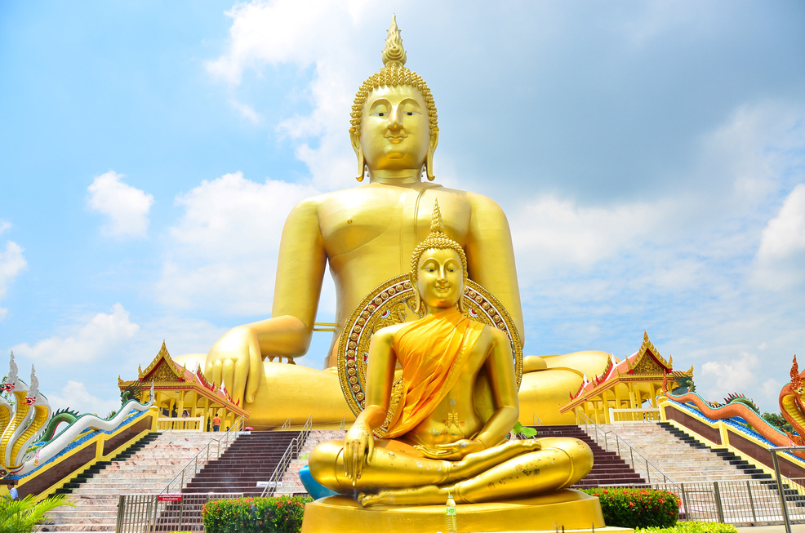
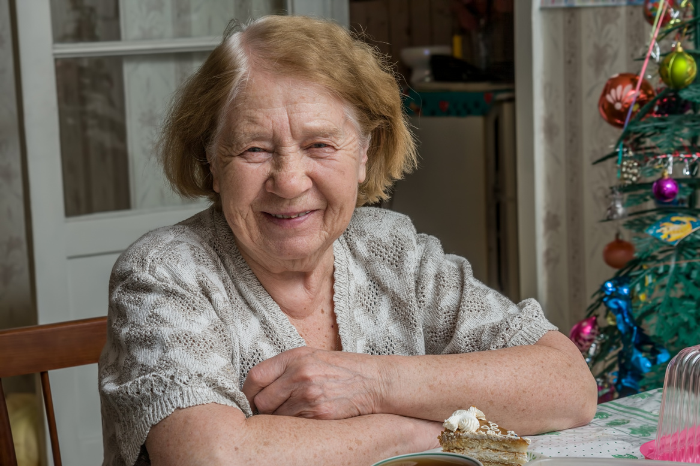
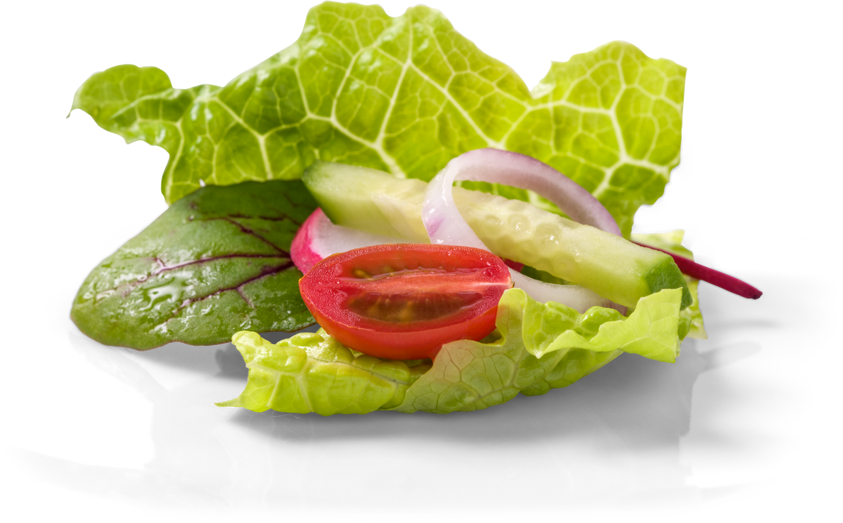
GUESSING GAME
1
??????
5 SYLLABLES

Slide 4
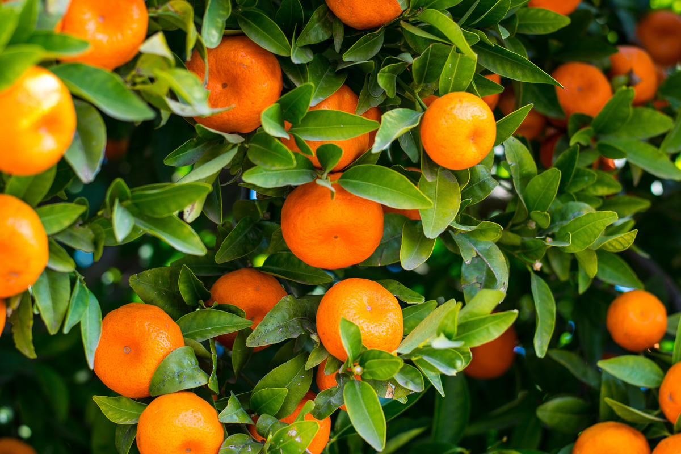

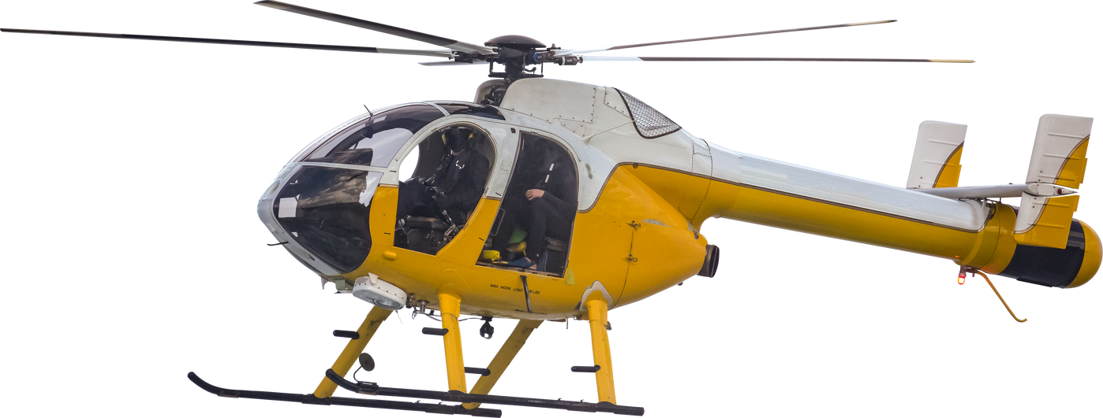

GUESSING GAME
??????
2
5 SYLLABLES

Slide 5

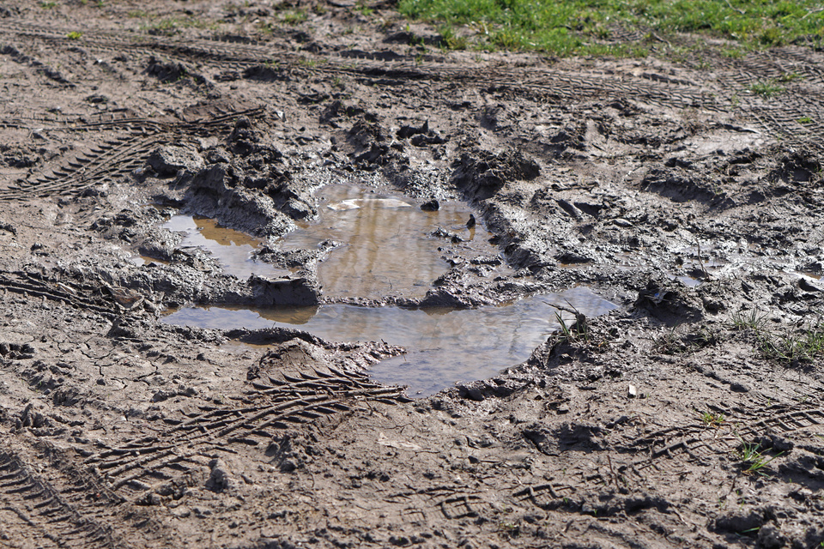
GUESSING GAME
??????
3
2 SYLLABLES

Slide 6



GUESSING GAME
4
??????
+
3 SYLLABLES

Slide 7


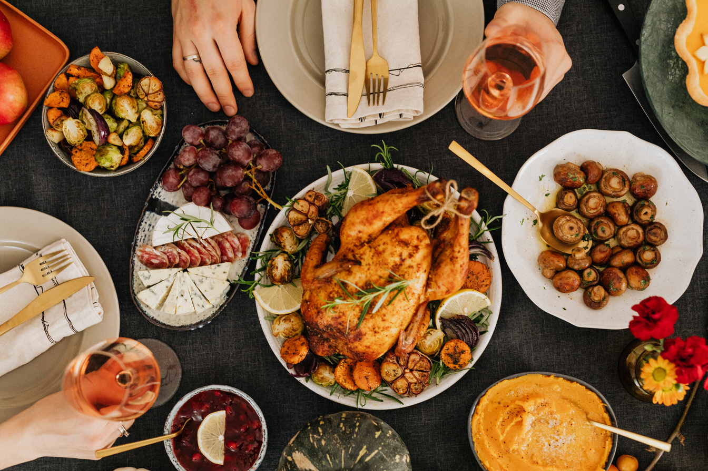
GUESSING GAME
5
3 SYLLABLES

Slide 8
GUESSING GAME
ANSWER
1. PAPAYA SALAD ส้มตำ
2. ORANGE BLACK COFFEE
3. SCONES แปลว่า สโคน
4. ROAST CHICKEN
5. HEALTHY FOOD

